Slide 1


Lessons learned from the early evolution of the Java Image Science Toolkit (JIST)
Bennett Landman
Vanderbilt University
September 24, 2010
Challenges of Collaborative Open-Source Development
Notes:
Challenges of Collaborative Open-Source Development: Lessons learned from the early evolution of the Java Image Science Toolkit
All software projects involve at least two programmers – the developer and the developer a short while later. Collaborative projects involve many individuals with their own strengths, weakness, opinions and preferences. In a successful project, it is imperative to recognize differing motivations and objectives of the supporting actors and to work with an infrastructure, both technical and procedural, which enables individual contributions. In this session, we examine the Java Image Science Toolkit (JIST), a framework for algorithm development that implicitly ensures tool interoperability, generates graphical user interfaces, provides advanced batch processing tools, and, most importantly, requires minimal additional programming or computational overhead. JIST has been used extensively in cortical surface extraction research, tissue segmentation, and diffusion weighted MRI modeling. JIST supports rapid prototyping with an efficient and practical approach to evaluate new algorithms. We will discuss the rationale and realization of the programming infrastructure, including an overview of the NIH Medical Image Processing and Visualization (MIPAV) platform, use of the Neuroimaging Informatics Tools and Resource Clearinghouse, and integrating Java with other programming environments (including ITK/VTK and Slicer3).

Slide 2



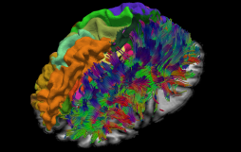
Overview
Motivation
Challenges
Licensing
Collaboration
Conclusion
JIST: Motivation
Setting Objectives
Choosing a License
Enabling Collaboration
Closing Thoughts
p

Slide 3
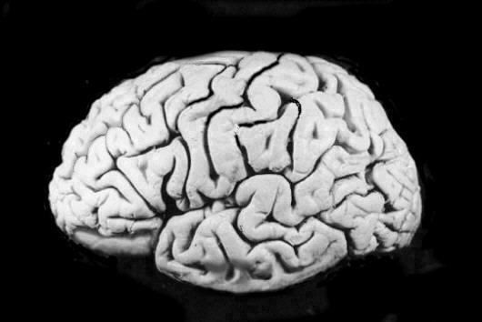
Motivation
Challenges
Licensing
Collaboration
Conclusion

Slide 4
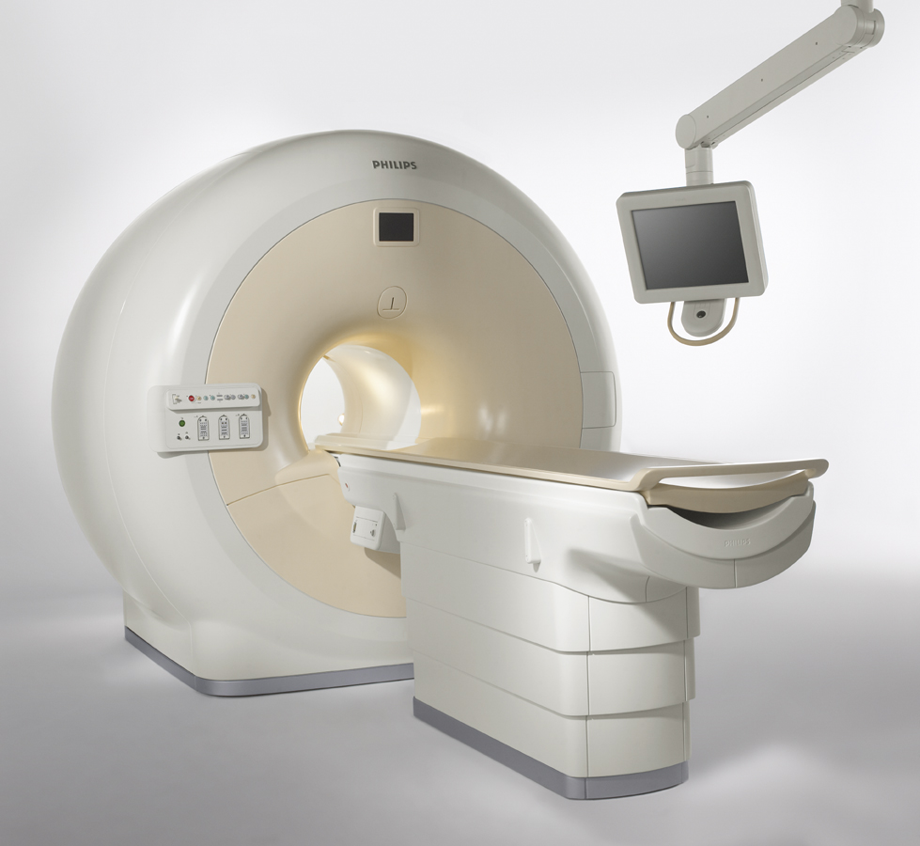
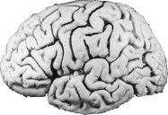
Motivation
Challenges
Licensing
Collaboration
Conclusion

Slide 5
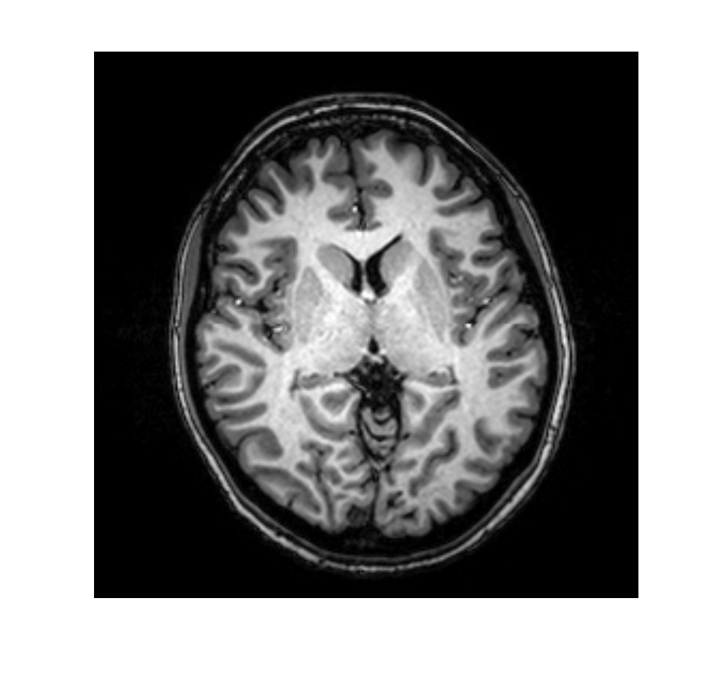
Motivation
Motivation
Challenges
Licensing
Collaboration
Conclusion

Slide 6
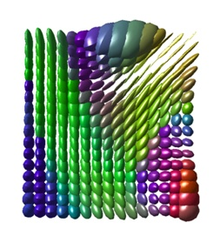
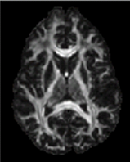
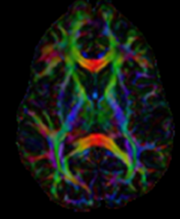
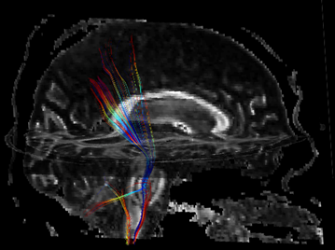
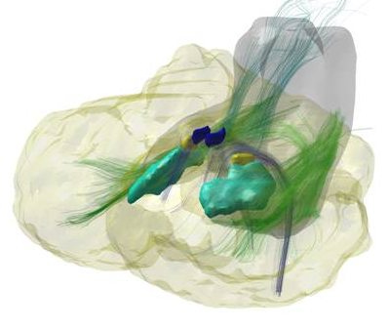
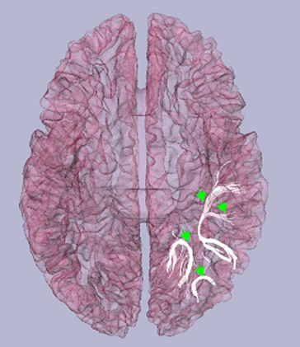
Enable new modes of inqury
Motivation
Motivation
Challenges
Licensing
Collaboration
Conclusion

Slide 7
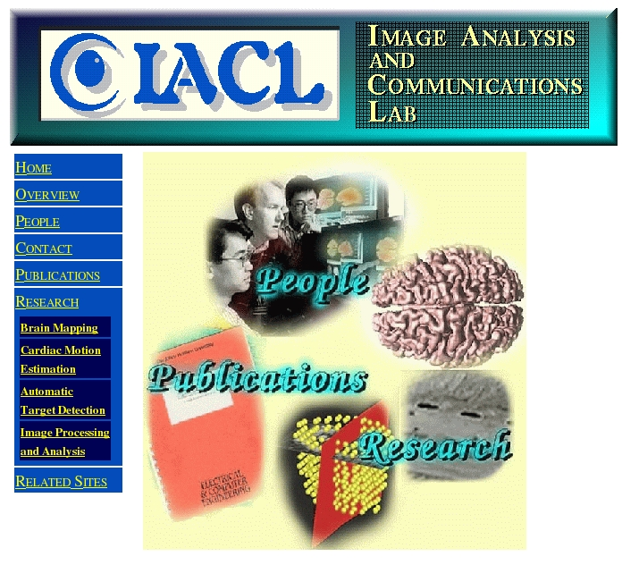
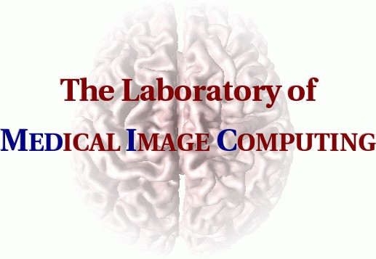
Johns Hopkins Circa 2004
Motivation
Challenges
Licensing
Collaboration
Conclusion

Slide 8
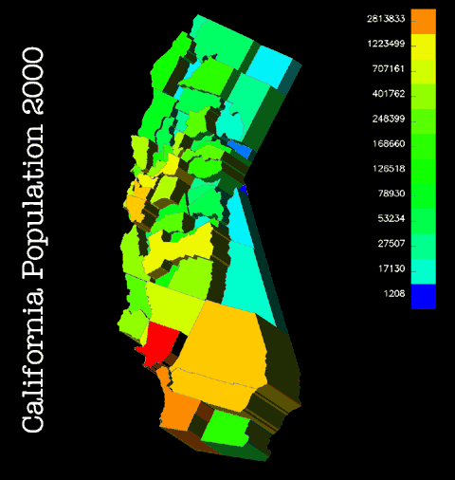
Rise of JIST
Motivation
Motivation
Challenges
Licensing
Collaboration
Conclusion
Decades of experience
>500 Publications
435,000 lines of code
Scores of programs
1 cvs repository
C/C++ code compiled on SGI and Linux
Primary visualization engine (OpenDX) reaching end-of-life-cycle
http://www.opendx.org

Slide 9
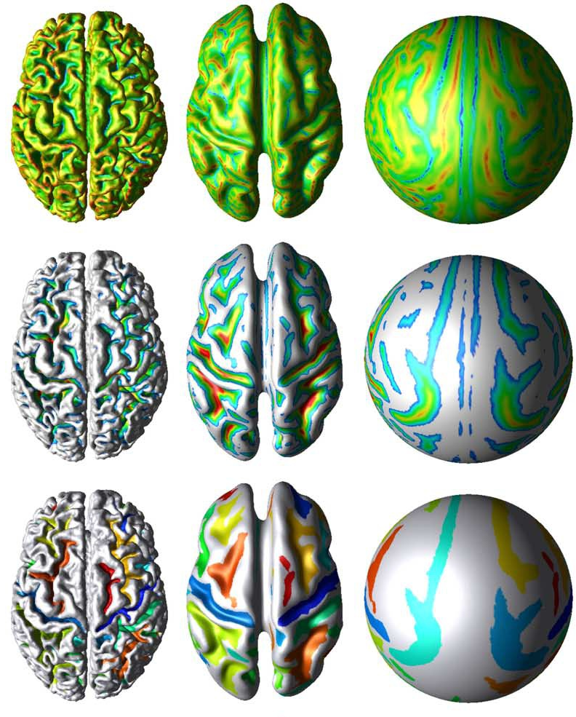
Concerns
Motivation
Challenges
Licensing
Collaboration
Conclusion
Limited ability to consistently share code and software
  All or none
Limited ability to pipeline / flexibly script
Proprietary data formats
Concerns with on going extensibility
CRUISE: Cortical reconstruction using implicit surface evolution (2004)

Slide 10
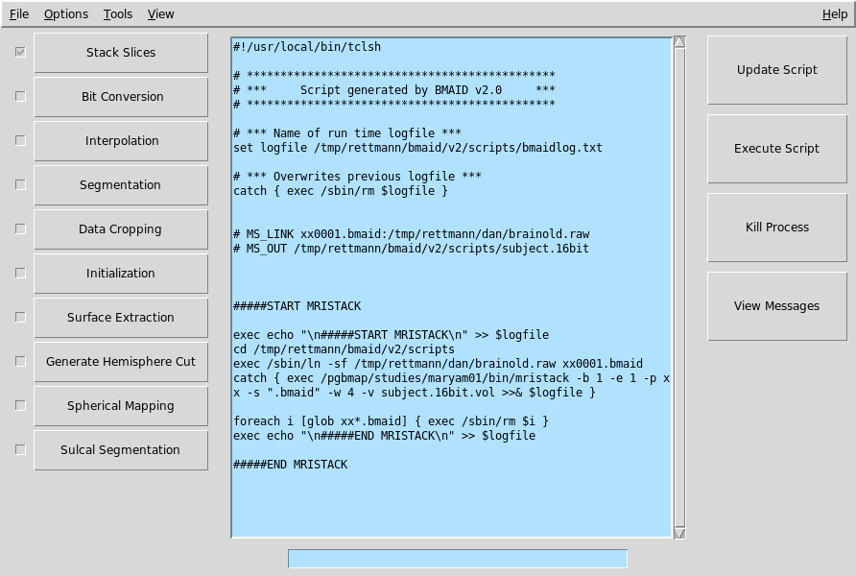
User Interface Circa 2004
Motivation
Challenges
Licensing
Collaboration
Conclusion

Slide 11

Motivation
Motivation
Challenges
Licensing
Collaboration
Conclusion
2004
2010

Slide 12
User Interface Circa 2010
Motivation
Challenges
Licensing
Collaboration
Conclusion
Visual Programming Layout Environment
Multi-CPU / Multi-Processor / G RID
Job Scheduling

Slide 13

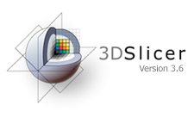
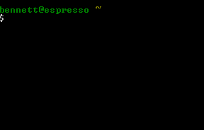
JIST Today: Software
Motivation
Challenges
Licensing
Collaboration
Conclusion
Modular architecture
Industry standard data representation
Visual programming environment
Visual process control
Interoperable
  MIPAV (NIH)
  Slicer3 (NAMIC)
  Command Lines Tools (FSL, AFNI, etc.)

Slide 14
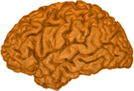
JIST Today: Lines of Code
Motivation
Challenges
Licensing
Collaboration
Conclusion
3754 Downloads Since June 2009
Private and Collaborators
Release
104,952
Open Source
78,563
JIST Core
52,331

Slide 15
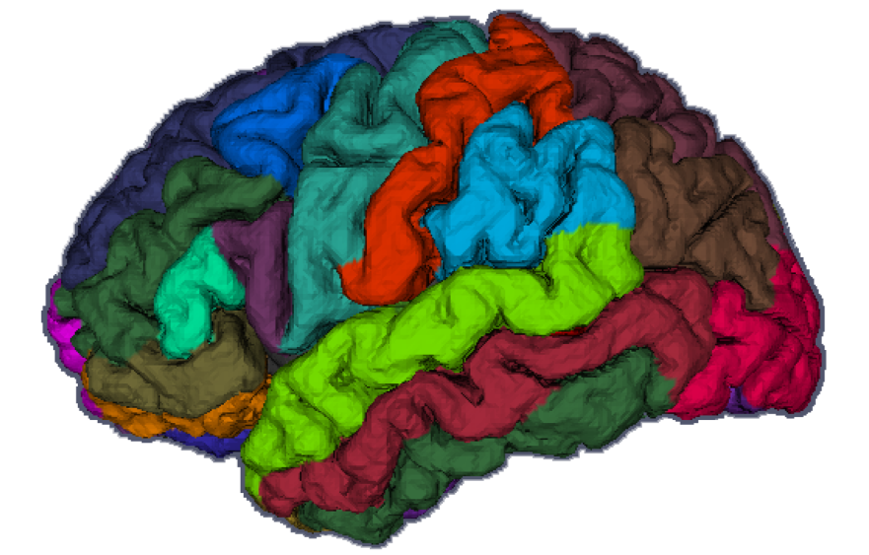

JIST Today: Science
Motivation
Challenges
Licensing
Collaboration
Conclusion

Slide 16

Don’t rock the boat
Motivation
Challenges
Licensing
Collaboration
Conclusion
Tradition of Success
  Academic rigor
  Supporting curiosity
  Large code base
  Verifiable code
  Quick execution
Change for the sake of change is a bad idea

Slide 17

Legacy Challenges
Motivation
Challenges
Licensing
Collaboration
Conclusion
Expanding Collaborations
  Development
  Data Analysis
Interoperability
  Data representation
  Data formats
  Program execution
Support
  Programmers
  End users

Slide 18
Differing Objectives
Motivation
Challenges
Licensing
Collaboration
Conclusion
Lead Investigator
Graduate Students
Clinical Colleagues
Engineering Collaborators
Increase scientific impact of research

Slide 19
Differing Objectives
Motivation
Challenges
Licensing
Collaboration
Conclusion
Lead Investigator
Graduate Students
Clinical Colleagues
Engineering Collaborators
Graduate

Slide 20
Differing Objectives
Motivation
Challenges
Licensing
Collaboration
Conclusion
Lead Investigator
Graduate Students
Clinical Colleagues
Engineering Collaborators
Answer clinical research questions

Slide 21
Differing Objectives
Motivation
Challenges
Licensing
Collaboration
Conclusion
Lead Investigator
Graduate Students
Clinical Colleagues
Engineering Collaborators
Understand and advance engineering science

Slide 22

User Requirements
Motivation
Challenges
Licensing
Collaboration
Conclusion
User-interface
Stability (bug tolerance)
Extensibility
Compatibility

Slide 23



Trap : Buzzword Bingo
Motivation
Challenges
Licensing
Collaboration
Conclusion
Paradigms for Software Development
  Agile Software Development
  Extreme Programming
  Scum
  Spiral
  Waterfall
  V-Model
  …

Slide 24

“We’re not a software shop.”
Motivation
Challenges
Licensing
Collaboration
Conclusion
Academic priorities are on science not product.
  Discover new algorithms and build understanding
  Enable new types of clinical hypothesis.
Secondarily, increase impact of successful research progress.

Slide 25

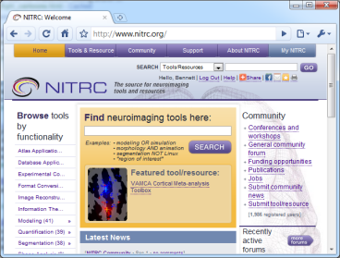

Scientists not Programmers
Motivation
Challenges
Licensing
Collaboration
Conclusion
Rapid Prototyping
  Test early
  Test often
Incremental Improve
  Implement
  Validate
  Verify
  Release
Support for Modular Domains of Expertise

Slide 26
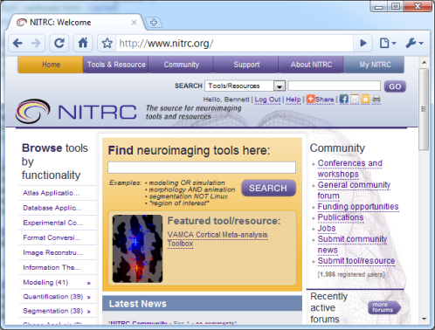
Neuroimaging Informatics Tools and
Resources Clearinghouse (NITRC)
Motivation
Challenges
Licensing
Collaboration
Conclusion
Development
  Source Control (cvs|svn)
  User registration / roles / privileges
  Download management
Support
  Forums
  E-mail lists
  Wiki space
Community support
  Related and derived Projects

Slide 27
MIPAV
Motivation
Challenges
Licensing
Collaboration
Conclusion
A project of NIH Intramural (CIT)
  Advanced visualization
  Quantitative imaging calculations
  Manual interaction and labeling
  Over 70 support imaging formats
  Cross-platform java implementation

Slide 28
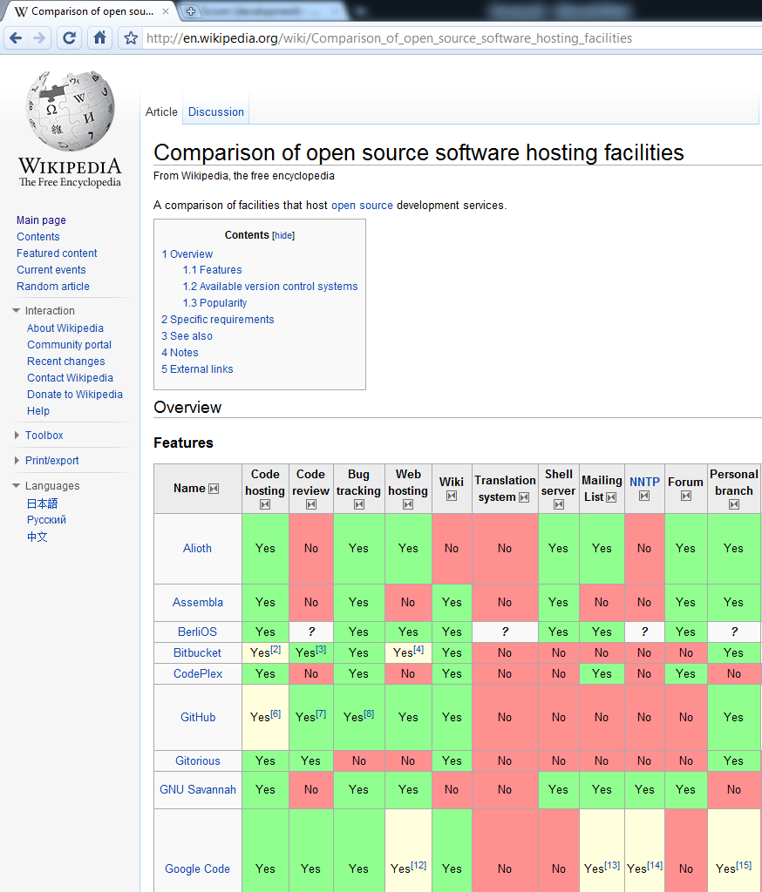
Other Resources
Motivation
Challenges
Licensing
Collaboration
Conclusion
Image Analysis
  ITK/VTK
  ImageJ (being merged with MIPAV)
  SPM
  AFNI
  FSL
List of Source Hosting Services

Slide 29

Licensing
Motivation
Challenges
Licensing
Collaboration
Conclusion
Choose an appropriate license for your development plans BEFORE you begin development
Verify that you comply with the terms of other licenses
Define the copyright holder
  Include years of contribution

Slide 30
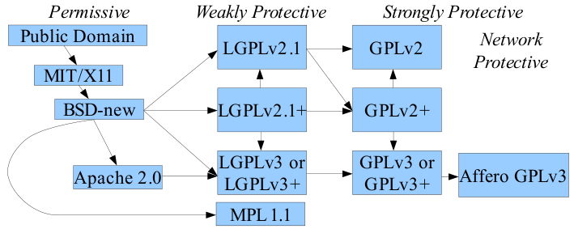
Incompatible Licenses
Motivation
Challenges
Licensing
Collaboration
Conclusion
Not all free software is equally free.
http://www.dwheeler.com/essays/floss-license-slide.html

Slide 31
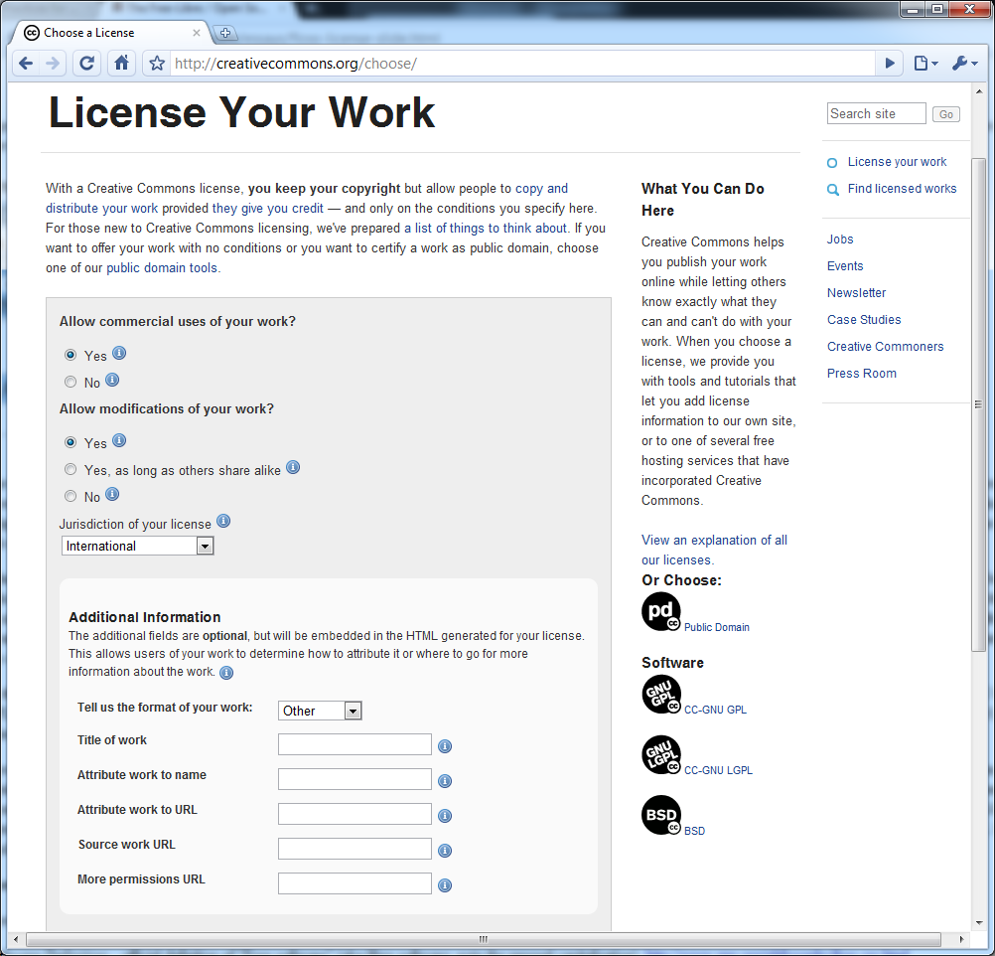
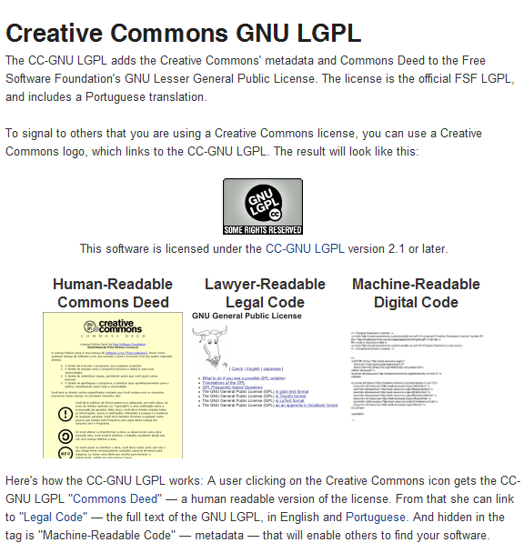
Creative Commons
Motivation
Challenges
Licensing
Collaboration
Conclusion
Please do not create your own license for FOSS.

Slide 32


Collaboration
Motivation
Challenges
Licensing
Collaboration
Conclusion
Islands impede science
  Data sharing
  Coding sharing
Platform dependence impedes innovation

Slide 33
Collaboration Infrastructure
Motivation
Challenges
Licensing
Collaboration
Conclusion
Source Control
Binary Releases
Documentation
Project Organization
Platform Integration

Slide 34
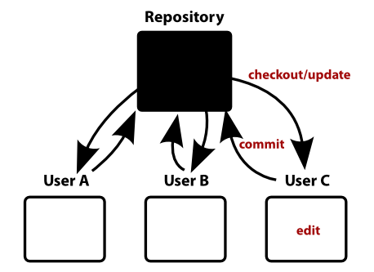
Source Control
Motivation
Challenges
Licensing
Collaboration
Conclusion
Permit asynchronous contributions, editing, updates for source code
CVS
  Classic, universal
SVN
  Unique versioning and better support for binaries
GIT
http://telin.ugent.be/~slippens/svn-intro/telin-svn-introduction.html

Slide 35
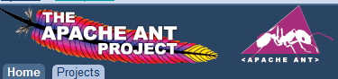
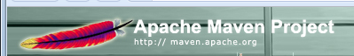
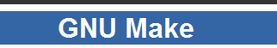
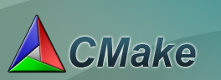
Controlling Confusion
Version control supports multiple simultaneous versions
Use fully automated scripts to
  Checkout
  Build
  Package

Slide 36

Bugs
Modern development environments
  “Printf” debugging is slow
  Line-by-line debugging is fast

Slide 37
Binary Releases
Motivation
Challenges
Licensing
Collaboration
Conclusion
Problem: Users want stable releases
  Stable releases require lots of testing
  Users want their bugs rapidly fixed
Version Everything!
  Make this version number obvious in program
Maintain a nightly build for testing
Release frequently (quarterly, semi-annual)

Slide 38
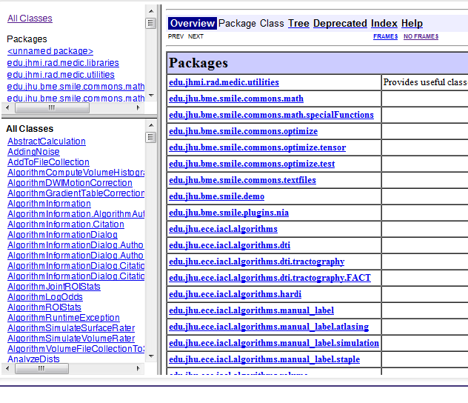
Documentation
Motivation
Challenges
Licensing
Collaboration
Conclusion
Document with examples
  Provide complete examples that users can follow with live data
  Wiki-Pages
Document in code
  Doxygen
  Javadoc

Slide 39
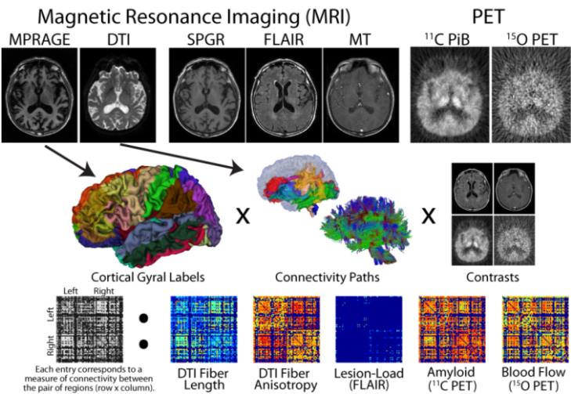
Project Organization
Motivation
Challenges
Licensing
Collaboration
Conclusion
Imaging involves
  Large datasets
  Heterogeneous data
  Hierarchical analysis
  Diverse software algorithms
  Varied data representation

Slide 40
Onion Architecture:
Layers of Responsibility
Motivation
Challenges
Licensing
Collaboration
Conclusion
Private and Collaborators
Release
104,952
Open Source
78,563
JIST Core
52,331

Slide 41
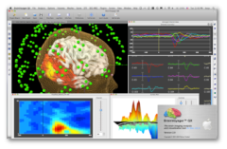
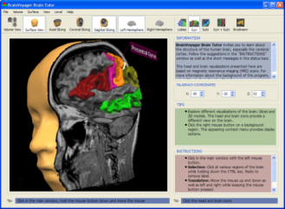
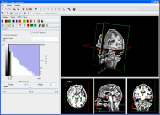
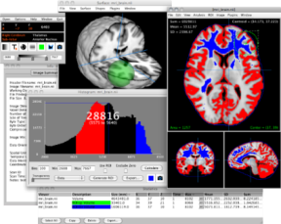
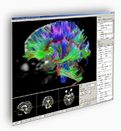
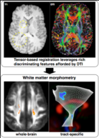
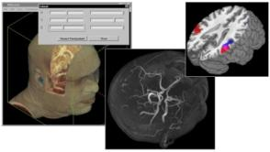
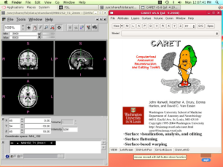
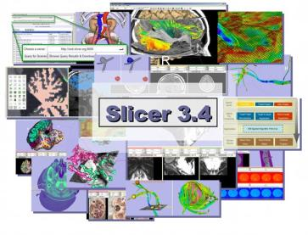
Platform Integration
Motivation
Challenges
Licensing
Collaboration
Conclusion
Our Software
Everyone Else

Slide 42
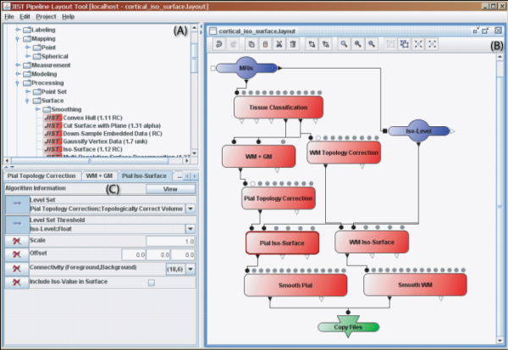
Critical Information
Motivation
Challenges
Licensing
Collaboration
Conclusion
Call Structure
  Input Parameters: name, type, valid range, default values
  Output Parameters: name, type, valid range
Execute
Meta-Data
  Citations, Authors, Release Information, License
  Description, Intended Use, Documentation

Slide 43
Expose Functionality
Motivation
Challenges
Licensing
Collaboration
Conclusion
Provide language independence through automatically generated command line interfaces.
cli usage: edu.jhu.ece.iacl.plugins.utilities.volume.MedicAlgorithmCrop [-h]
[-inBorderSize <arg>] [-inThreshold <arg>] [-inVolume <arg>]
[-outCropped <arg>] [-outExecution <arg>] [-outNew <arg>]
[-outOffset <arg>] [-outOriginal <arg>] [-xDebugLvl <arg>]
[-xDefaultMem <arg>] [-xDir <arg>] [-xFile <arg>] [-xJreLoc <arg>]
[-xMaxProcess <arg>] [-xml] [-xPrefExt <arg>] [-xSavePrefChanges]
[-xUseGridEng <arg>]
...
Provided by: JIST (Java Image Science Toolkit) Command Line Interface v0.1 http://www.nitrc.org/projects/jist/

Slide 44
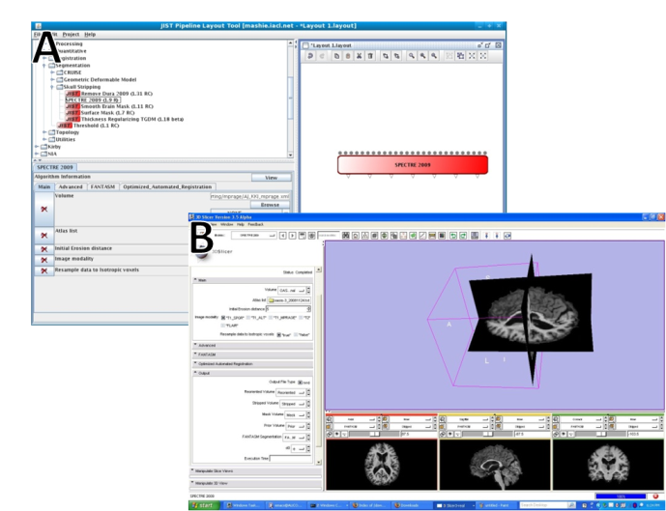
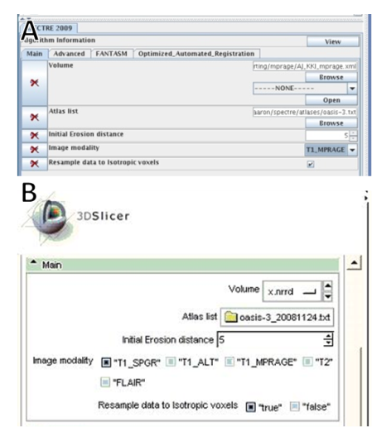
Program Interoperability
Motivation
Challenges
Licensing
Collaboration
Conclusion
JIST
JIST
SLICER
SLICER

Slide 45
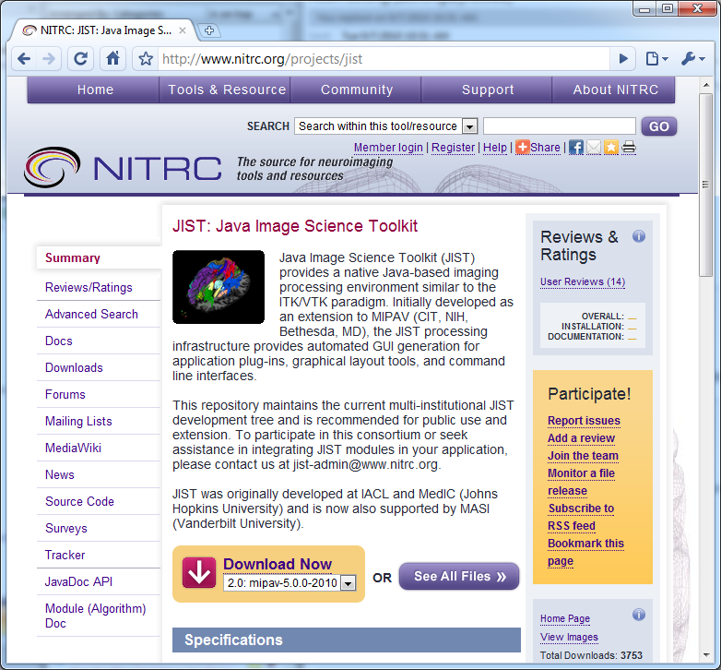
Closing Thoughts
Motivation
Challenges
Licensing
Collaboration
Conclusion
JIST has transformed our research workflow
  Enabled larger projects
  More contributors
  Easier dissemination of results
  Provided for structured software release
There have been growing pains

Slide 46
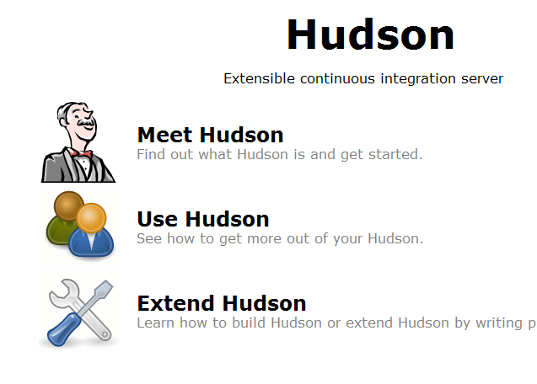
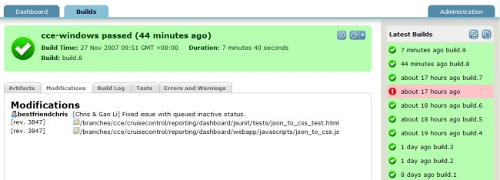
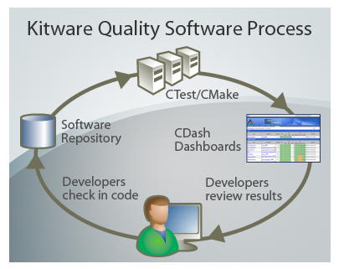
Continuous Testing
Motivation
Challenges
Licensing
Collaboration
Conclusion
Continuous build system
  Perform automated algorithm testing
  Detect problems as they arise
  Fix mistakes before they propagate
  Prevent mistakes from reoccurring

Slide 47
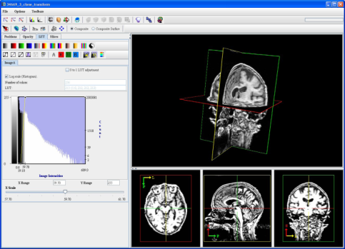

Continuing Challenges
Motivation
Challenges
Licensing
Collaboration
Conclusion
  Real-time on-line processing
  Web service embedding
  Leverage existing support for Uniform Resource Identifiers (URIs )
  Continuing to address privacy, security, and data use concerns

Slide 48

Try out JIST:
Virtualized Development
Motivation
Challenges
Licensing
Collaboration
Conclusion
Ubuntu 10.04 LTS
  MIPAV
  JIST
  Source Control (NITRC)
  Automated build
  Eclipse Development
Download from NITRC JIST Project

Slide 49



Thank you.
Johns Hopkins University
Johns Hopkins University
School of Medicine
Vanderbilt University

Slide 50
Questions
?

