Slide 1
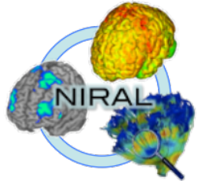

Diffusion Imaging Quality Control with DTIPrep
Martin Styner, PhD
University of North Carolina
Neuro Image Research and Analysis Lab

Slide 2
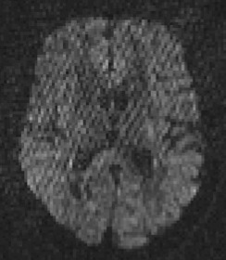
DWI/DTI QC
This tutorial teaches you how to do quality control (QC) of diffusion images both for DTI as well as other diffusion models (such as HARDI)
DWI/DTI QC is performed with the NA-MIC tool DTIPrep
  Can be called within Slicer
  Also stand-alone tool

Slide 3

Dataset
For this tutorial you will need some DWI/DTI data files that can be found on this link :
http://hdl.handle.net/1926/1759

Slide 4
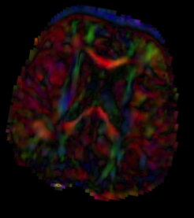
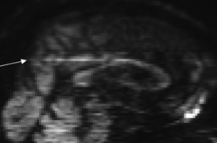
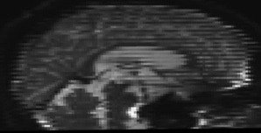
Diffusion Artifacts
Diffusion images are sensitive to a number of artifacts
Motion
Eddy-current distortions
Noise/SNR issues
Vibrational artifacts
Venetian blind artifacts
“unknown”…
Bad DWI’s are removed

Slide 5
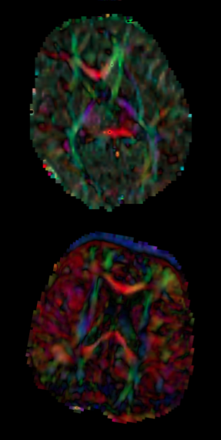
Outline
DTI QC pipeline
  Start DTIPrep
  Load DWI dataset
    Check DWI & gradient info
  Protocol for Automatic QC
  Run Automatic QC on DWI
  Final Visual QC
  Check DTI glyphs in Slicer

Slide 6

DTIPrep
Stand alone/Slicer module
NITRC page: http://www.nitrc.org/projects/dtiprep/
  Additional manual on NITRC page
Protocol based QC
  Protocol defines all the parameters
Automatic report creation
Embed/Cropping of DWI data
  Same size images => simplifies processing
Visualization of gradient scheme

Slide 7
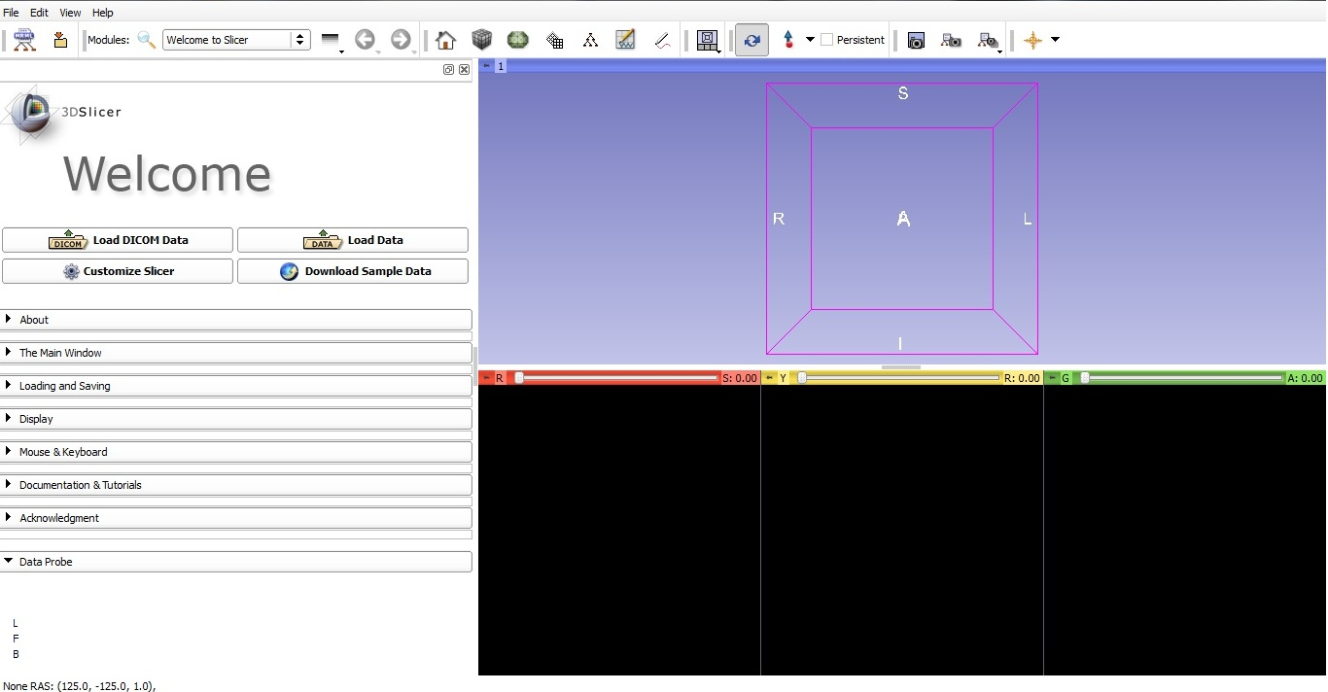
Start Slicer 4
Linux/Mac users :
Launch the Slicer
executable located in
the Slicer4 directory
Windows users :
Select Start→All Programs→Slicer4.0.1→Slicer
Or launch the Slicer executable from Slicer4 directory

Slide 8
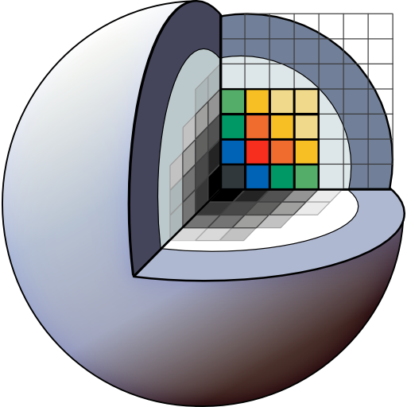
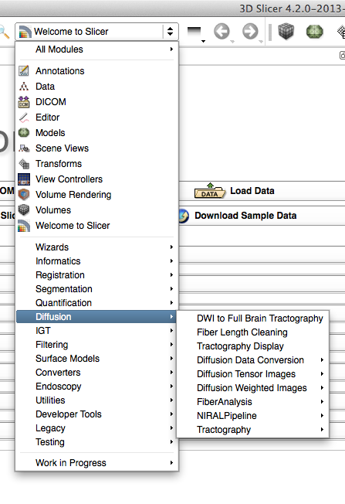
Start DTIPrep within Slicer
Select DTIPrep
  Diffusion category
Create new module
Click “Apply”
DTIPrep starts up

Slide 9
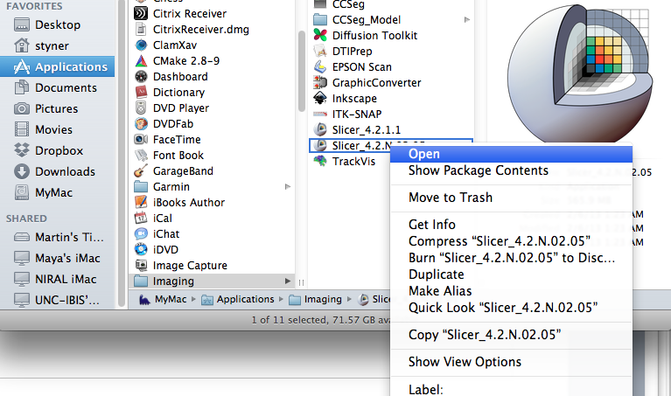
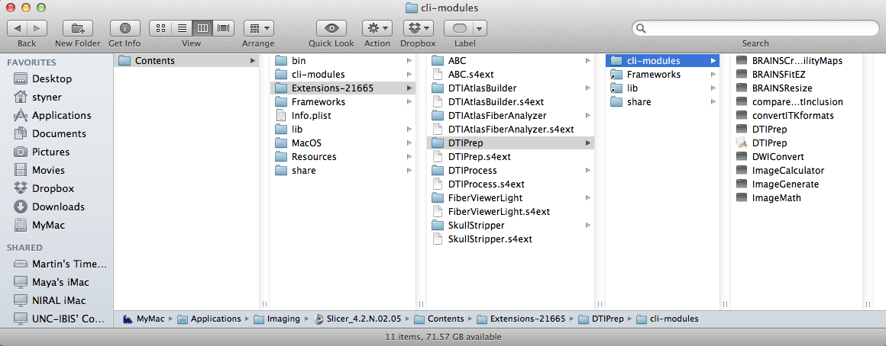
Workaround on Mac
Show Package Contents on Slicer
Go to Extensions => DTIPrep => cli-modules => DTIPrep

Slide 10
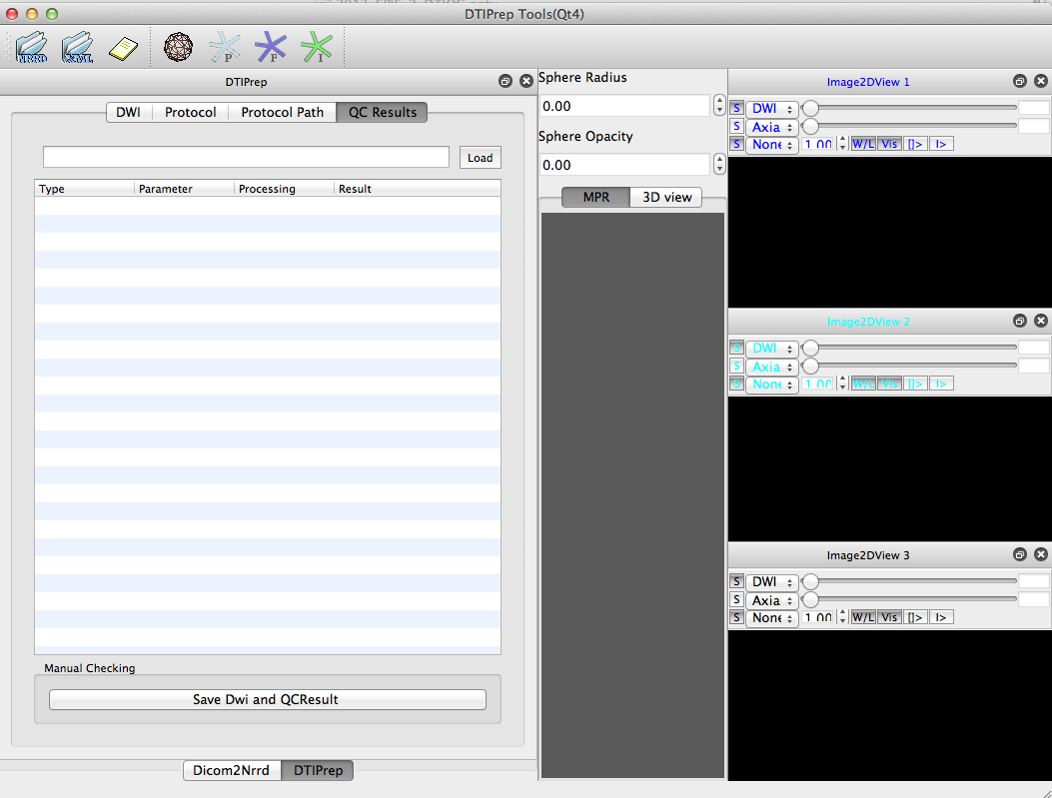
DTIPrep Main Window
Toolbar
DWI Viewers
Info Window
3D Viewer

Slide 11
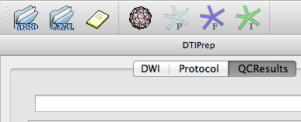
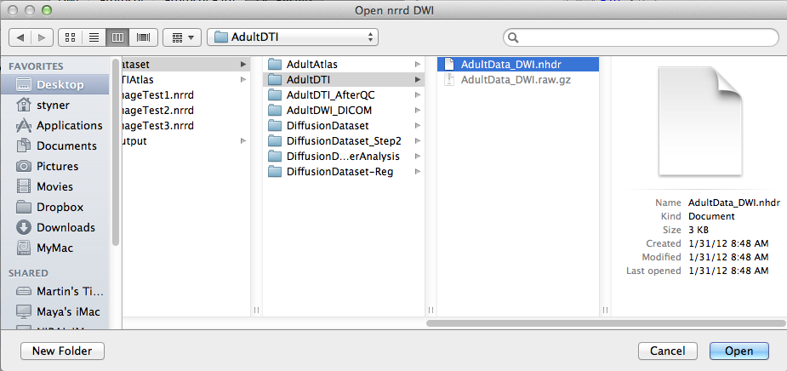
Load DWI image
Click NRRD icon
File Dialog
  Select your DWI
  AdultData_DWI.nhdr
“Open”
Done with loading

Slide 12
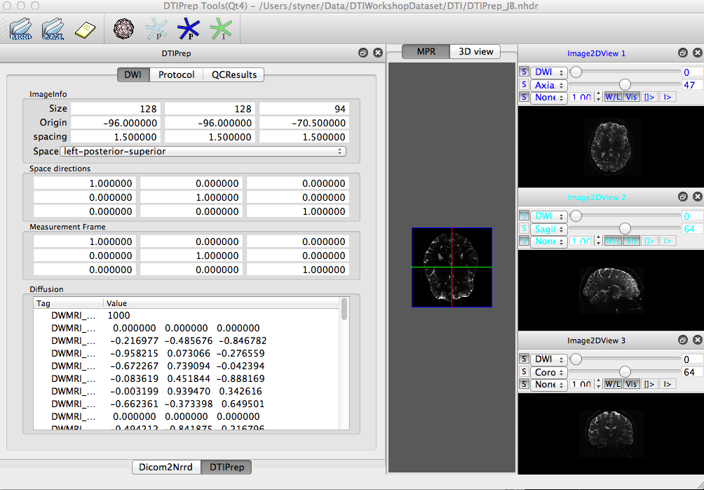
DWI info
Detailed
DWI
Info

Slide 13
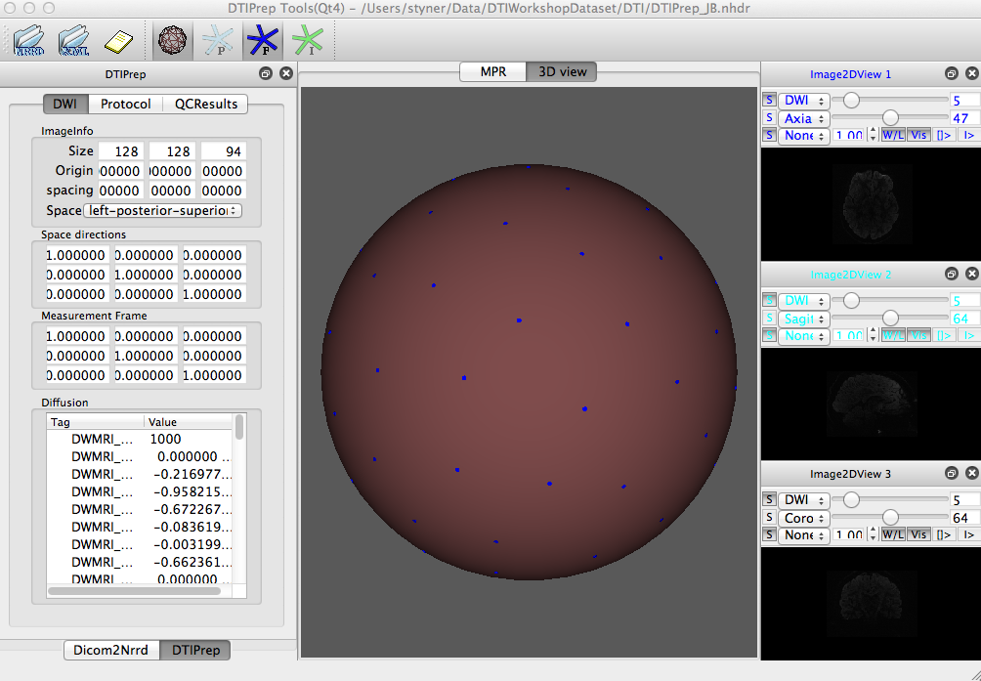
Gradient info in 3D
Displays gradient scheme on unit sphere
(F = File)
Check for uniformity

Slide 14
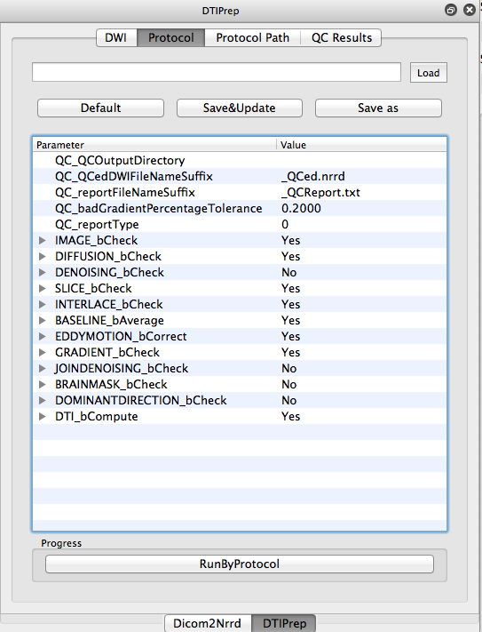
Protocol in DTIPrep
Protocol defines parameters
Use default parameters or load prior parameter set
Select “Protocol” tab
Select “Default”
Detailed parameters
  See manual on NITRC

Slide 15
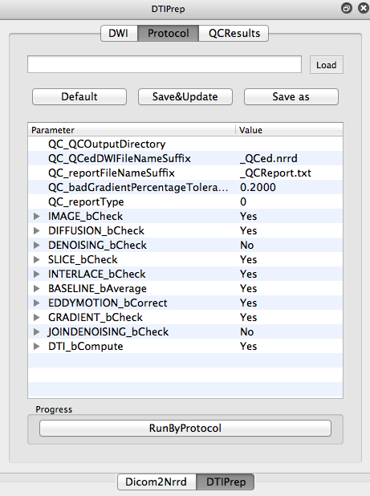
Run QC
Select “RunByProtocol”
  Runs for a few minutes (5-15)
Checks:
Image dimensions
Gradients directions
Intensity changes across slices
Excessive motion across slices
motion and eddy current correction
Residual motion detection
Optional noise removal

Slide 16
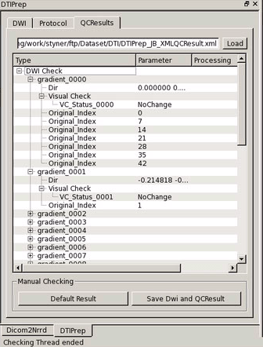
QC Result
Loads QC’ed DWI when finished
Detailed reporting
Directions after motion correction
Reasons for exclusion

Slide 17

Visual QC & Save
Double click on “VC_Status”
Option to include or exclude
Often unnecessary

Slide 18
Conclusion
DTI QC is a must
DTIPrep & Slicer provide comprehensive QC
This tutorial guided you through the “default” use of DTIPrep
Soon v1.2: Better Slicer integration, directional artifacts detection, and residual error estimation

Slide 19
Acknowledgment
National Alliance for Medical Image Computing
NIH U54EB005149
UNC: Mahshid Farzinfar, Zhexing Liu, Jean-Baptiste Berger, Clement Vachet, Cheryl Dietrich, Rachel Smith, Eric Maltbie, Yundi Shi, Aditya Gupta, Francois Budin
Utah: Guido Gerig, Sylvain Gouttard
Iowa: Hans Johnson, Joy Matsui

